Slide 1



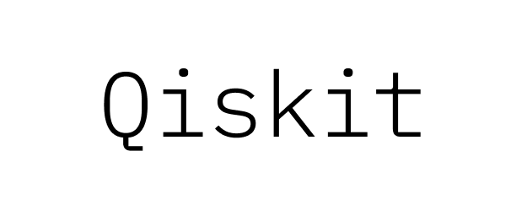

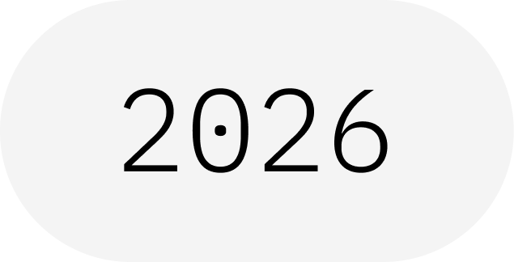
State Tomography
Figuring Out Where the Needle Really Points
IBM Quantum School
Saad Ejaz • Guest Speaker
Qiskit Fall Fest 2026 at University of Engineering & Technology Lahore,Narowal Campus

Slide 2
01
SPEAKER INTRODUCTION
Saad Ejaz
Guest Speaker
Computer Engineering student and IBM Quantum School tutor, introducing state tomography from the Bloch-sphere picture and building toward measurement-based state reconstruction.
IBM Quantum School
Qiskit Fall Fest 2026 at University of Engineering & Technology Lahore,Narowal Campus

Slide 3
02
02
03
04
05
06
02
TABLE OF CONTENTS
01
The Measurement Problem
02
Measuring From Multiple Bases
03
Reconstructing the Bloch Vector
04
Basic Qiskit Implementation
05
Visualization
06
Results & Scalability
Qiskit Fall Fest 2026 at University of Engineering & Technology Lahore,Narowal Campus

Slide 4
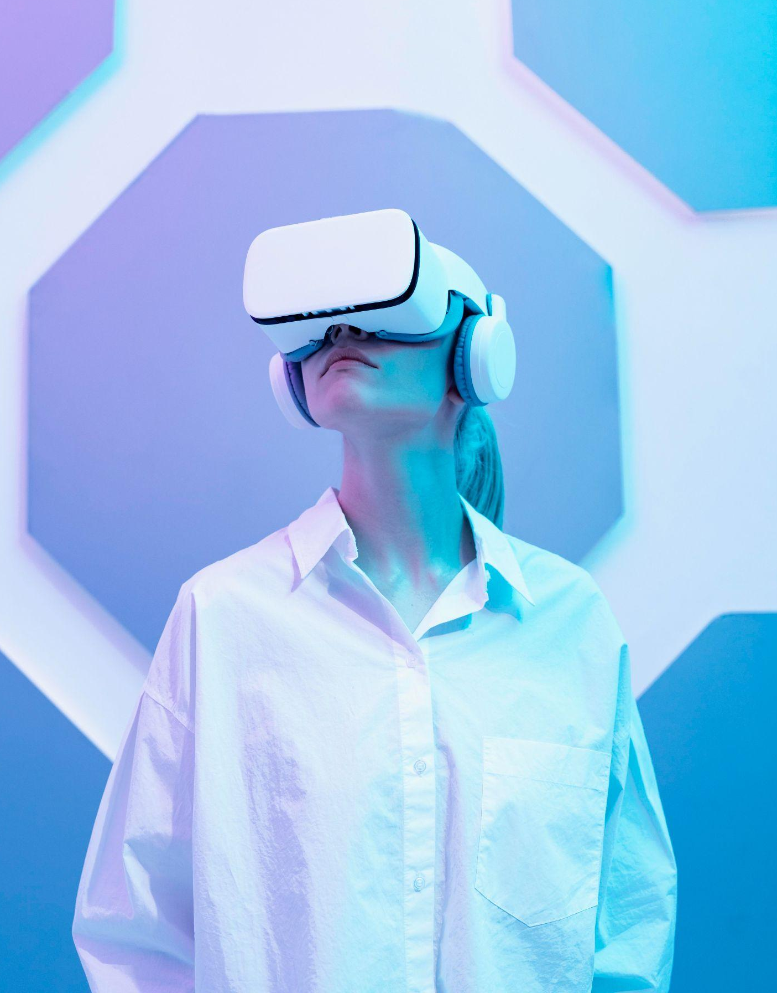
WHAT IS A QISKIT FALL FEST?
03
A beginner-friendly session on reconstructing an unknown single-qubit state from repeated measurements in different bases.
Qiskit Fall Fest 2026 at University of Engineering & Technology Lahore,Narowal Campus

Slide 5
03
04
INTRODUCTION
01
Qiskit Fall Fest 2026 at University of Engineering & Technology Lahore,Narowal Campus

Slide 6
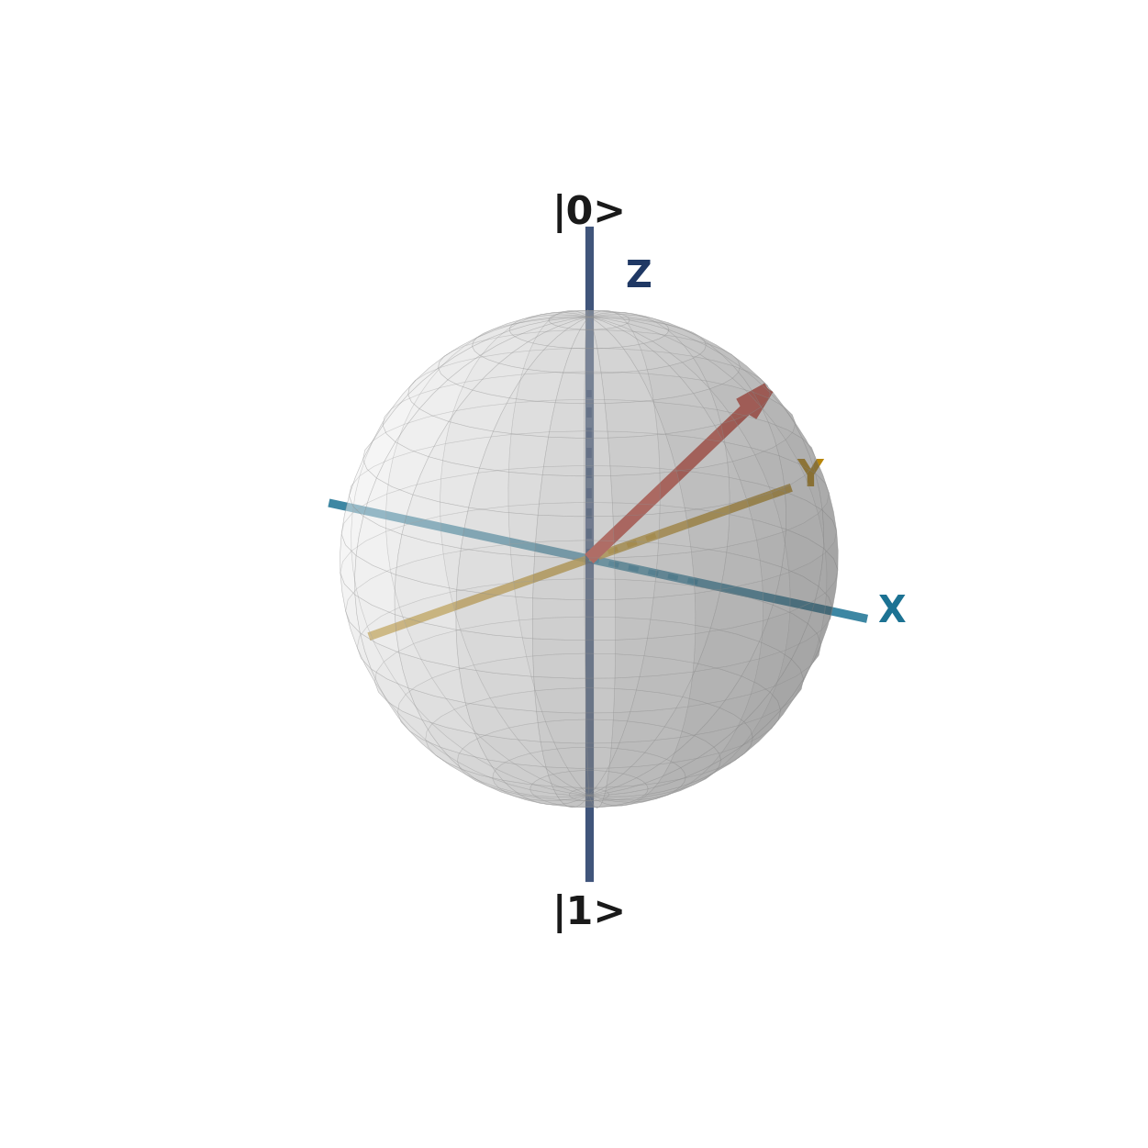
04
THE MEASUREMENT PROBLEM
You already know a qubit's state is a needle pointing somewhere on the Bloch sphere.
But you cannot directly see which way it points. The instant you measure it, the needle collapses to |0⟩ or |1⟩ — the original direction is gone.
If the same unknown state is prepared again and again, how can we discover where the needle was pointing?
Qiskit Fall Fest 2026 at University of Engineering & Technology Lahore,Narowal Campus

Slide 7
05
KEY CONCEPTS
UNKNOWN STATE
REPEATED DATA
The qubit is prepared in the same unknown state repeatedly.
Each measurement gives only a limited piece of information.
MULTIPLE BASES
RECONSTRUCTION
Measure along Z, X, and Y to recover three coordinates.
Combine the three coordinates to rebuild the Bloch vector.
Qiskit Fall Fest 2026 at University of Engineering & Technology Lahore,Narowal Campus

Slide 8
06
07
MEASUREMENT BASES
02
Qiskit Fall Fest 2026 at University of Engineering & Technology Lahore,Narowal Campus

Slide 9
07
MEASURING FROM MULTIPLE BASES
A single measurement gives only “up” or “down” — one bit of information. That is not enough to determine a 3D direction.
Z DIRECTION
X DIRECTION
Y DIRECTION
Straight up / down
Left / right
Front / back
The ordinary computational-basis measurement.
Apply an H gate first, then measure.
Use a different basis-changing operation, then measure.
Qiskit Fall Fest 2026 at University of Engineering & Technology Lahore,Narowal Campus

Slide 10
08
THE THREE MEASUREMENT DIRECTIONS
Z
Each measurement direction gives one coordinate of the unknown state.
unknown Bloch vector
Z → z
X → x
Y → y
X
Y
Qiskit Fall Fest 2026 at University of Engineering & Technology Lahore,Narowal Campus

Slide 11
09
10
MATHEMATICAL FORMULATION
03
Qiskit Fall Fest 2026 at University of Engineering & Technology Lahore,Narowal Campus

Slide 12
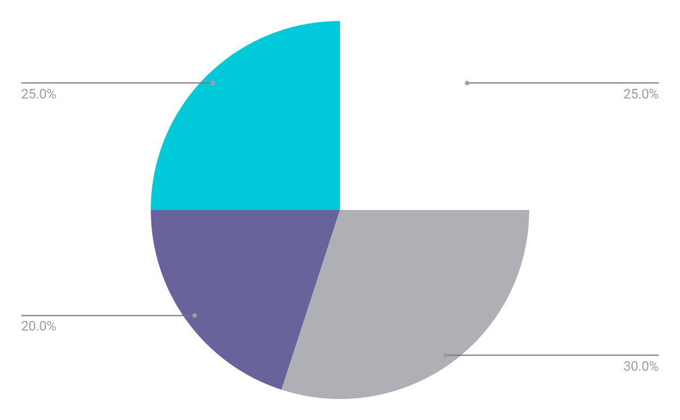
10
RECONSTRUCTING THE BLOCH VECTOR
For each direction, average many measurement results:
z = (fraction of "up" results) − (fraction of "down" results)
Do the same subtraction for X and Y to obtain x and y.
needle position = ( x , y , z )
More repeats per direction reduce statistical fluctuations and make the reconstruction more accurate.
Qiskit Fall Fest 2026 at University of Engineering & Technology Lahore,Narowal Campus

Slide 13
11
BASIC QISKIT IMPLEMENTATION
CODE
# Measure the same unknown qubit in three different bases
for basis in ["Z", "X", "Y"]:
qc = unknown_qubit_circuit()
if basis == "X": qc.h(0)
if basis == "Y": qc.sdg(0); qc.h(0)
qc.measure_all()
counts = run(qc, shots=4000)
p0 = counts["0"] / 4000
p1 = counts["1"] / 4000
coordinate[basis] = p0 - p1
needle = (coordinate["X"], coordinate["Y"], coordinate["Z"])
This is the basic shape from the supplied lecture. The complete lab is separate.
Z → z
X → x
Y → y
Qiskit Fall Fest 2026 at University of Engineering & Technology Lahore,Narowal Campus

Slide 14
12
13
VISUALIZATION
04
Qiskit Fall Fest 2026 at University of Engineering & Technology Lahore,Narowal Campus

Slide 15
13
MEASUREMENT AXES ON THE BLOCH SPHERE
UNKNOWN NEEDLE
The red arrow represents the unknown state.
THREE AXES
X, Y, and Z are the three directions used to collect enough information for reconstruction.
SHADOWS
Qiskit Fall Fest 2026 at University of Engineering & Technology Lahore,Narowal Campus
Each projection gives one coordinate of the Bloch vector.

Slide 16
14
RESULTS
05
Qiskit Fall Fest 2026 at University of Engineering & Technology Lahore,Narowal Campus

Slide 17
15
RECONSTRUCTED STATE
The three measured coordinates are combined into one reconstructed Bloch vector.
With finite shots, the reconstructed vector can differ slightly because tomography is an estimation process.
Qiskit Fall Fest 2026 at University of Engineering & Technology Lahore,Narowal Campus
True state
Reconstructed

Slide 18
16
17
FINITE SHOTS
Tomography is an estimation process.
100 shots
More shots generally reduce statistical fluctuations.
Fewer shots → noisier estimate
More shots → more stable estimate
Real-device noise can introduce additional deviations.
4096 shots
The supplied lab material demonstrates low-shot versus high-shot tomography.
Qiskit Fall Fest 2026 at University of Engineering & Technology Lahore,Narowal Campus

Slide 19
18
SCALABILITY
17
FOR ONE QUBIT
FOR n QUBITS
Three measurement settings: X, Y, and Z.
Full tomography requires 3ⁿ combinations of measurement settings, as described in the supplied lecture.
02
KEY POINT
03
Full state tomography becomes difficult to scale as the number of qubits grows.
Qiskit Fall Fest 2026 at University of Engineering & Technology Lahore,Narowal Campus

Slide 20
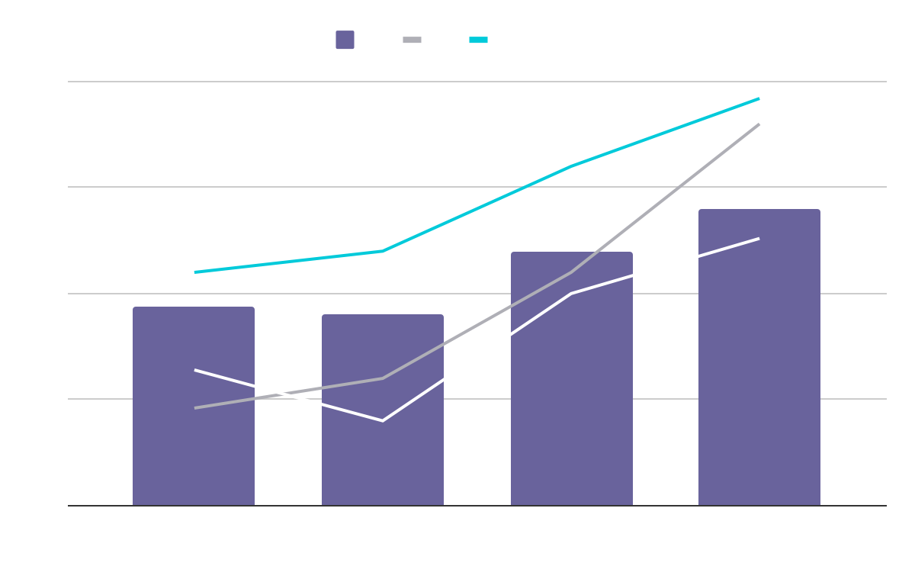
19
TOMOGRAPHY WORKFLOW
 | v1 | v2 | v3
Item 1 | 500 | 2,000,000 | 40
Item 2 | 1,000 | 50,750 | 10
Item 3 | 250 | 1,500,000 | 300
Item 4 | 500 | 2,000,000 | 40
Item 5 | 1,000 | 50,750 | 10
Item 6 | 250 | 1,500,000 | 300
18
02
03
01
02
03
04
05
Prepare
Measure
Repeat
Reconstruct
Inspect
Prepare the unknown state.
Measure in different bases.
Collect measurement statistics.
Combine results into the state description.
Visualize the reconstruction.
Qiskit Fall Fest 2026 at University of Engineering & Technology Lahore,Narowal Campus

Slide 21
19
RESOURCES
SOURCE LECTURE
The supplied State Tomography — Figuring Out Where the Needle Really Points deck.
IBM QUANTUM / QISKIT
Qiskit measurement and quantum-information documentation.
KEY TAKEAWAY
Tomography reconstructs a state description from repeated measurements in different bases.
Qiskit Fall Fest 2026 at University of Engineering & Technology Lahore,Narowal Campus

Slide 22
THANKS!
DO YOU HAVE ANY QUESTIONS?
20
Saad Ejaz • Guest Speaker
IBM Quantum School
Qiskit Fall Fest 2026 at University of Engineering & Technology Lahore,Narowal Campus

